Slide 1
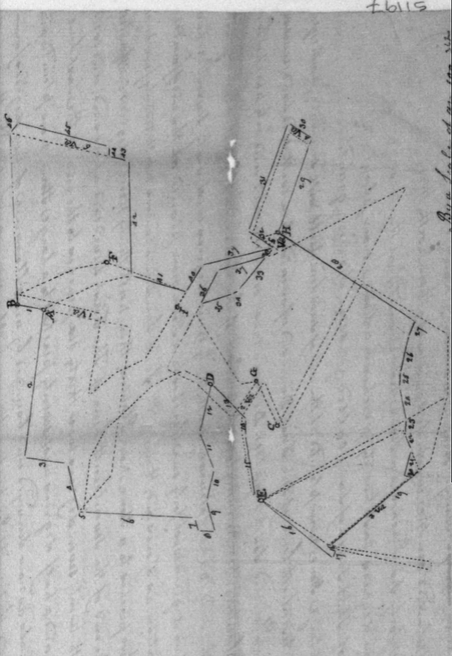
‘Auburn’ Survey: Col. Baker Johnson, 1804
(Frederick Co., Survey), ‘Auburn’, 934 acres, Baker Johnson, Patent# 362, 1804.)

Slide 2
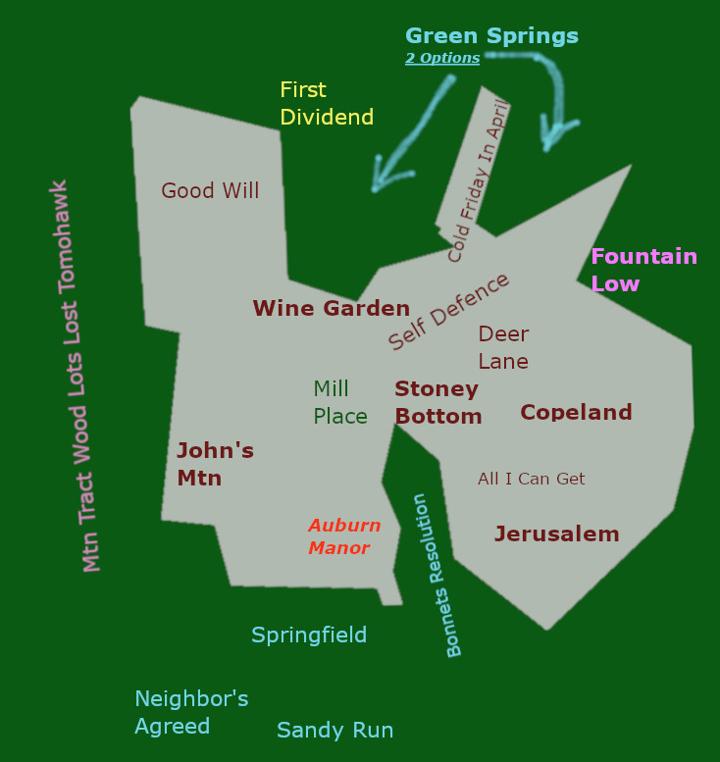
GIS & Historic Documents, Oral & Hidden Histories
The ‘Auburn’ Patent is a resurvey of many other surveys and resurveys, which began in the early 1700s & was both a product of and a creator of historical events and individuals. Using Historic-GIS & Ethnographic research, it is possible to re-create the Auburn of the past and uncover “hidden histories” of the diverse cultures who have lived here.
Image by M. Brandon, Property of Catoctin Furnace Historical Society

Slide 3
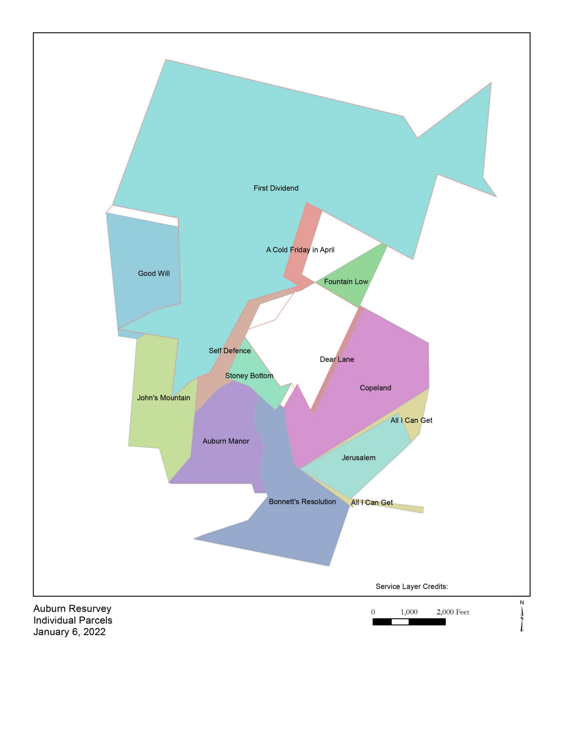
Robs Image
CITE!!

Slide 4
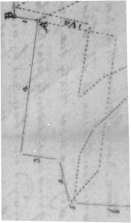
1. John's Mountain
(West-SW)
“It snuggled up against the foot of Catoctin Moutnain and lay immediately south of Catoctin Furnace.” (Tracey & Dern, p 214-5)
Vertrees family w/brother Hartman ‘Blue Spring’ tract being “located immediately south of John Verdriess’ land”, (Tracey & Dern, p 217)
John's Mt. Is connected to and runs along part of SpringField. ((Frederick Co., Survey), ‘Auburn’, 934 acres, Baker Johnson, Patent# 362, 1804.)
By researching the many deeds, surveys, and other historical documents, we have been able to locate such mysteries as ‘Blue Spring’, ‘John’s Mountain’, and the ‘Mountain Tract’. The ‘Mountain Tract’ survey which happened to also contain the ‘John’s Mountain’ plat and the details of how to find the ‘Wine Garden’ survey. This was then triangulated and with modern GIS technology we were able to map out and place the ‘Auburn’ Tract historically and geographically.
(Frederick Co., Survey), ‘Auburn’, 934 acres, Baker Johnson, Patent# 362, 1804

Slide 5
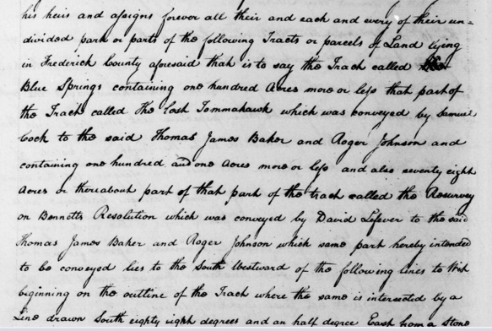
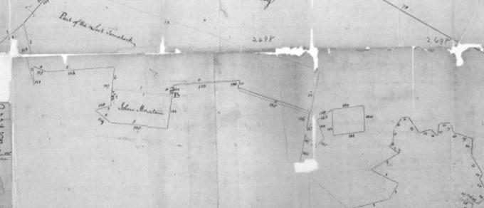
John’s Mountain … cont.
Mtn Tract, Blue Spring, Lost Tomohawk, et al.
The original patent for “John’s Mountain” spelled his name ‘John Nidress, Jr., and another parcel’s survey recorded his name as John Verdreys.” (Tracey & Dern, p 215)
(Frederick Co., Survey), Patent# 2698, ‘Mountain Tract’, 7715 acres, Benedict Calvert & Thomas Johnson, Jr, 1771.

Slide 6


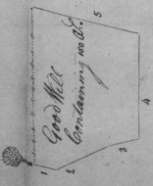

2. Good Will
~NW~
"Good Will" was surveyed with a beginning point on the West Boundary of "John's Mountain" ...and "John's Mtn" was noted "on the west side of Hunting Creek sixty perches above Mirey Lique,”<cite!! –deed/patent/Will> … according to the book, Pioneers of Old Monocacy, this “indicates the probable existence of a salt marsh in Verdriess’ day.”(Tracey & Dern, p 215)
Using the ‘Mountain Tract’ survey which contained the ‘John Mountain’ survey, and then with the Auburn survey and other documents, the location of ‘Good Will’ was established on the Auburn survey, which then helped to define the location of the ‘First Dividend’.
(Frederick Co., Survey), Patent# 1681, ’Good Will’, 150 acres, Dr. Charles Carroll, 1765.

Slide 7
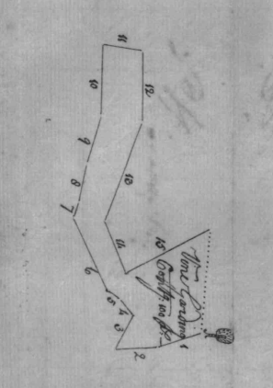
3. Wine Garden (North-Center)(?)
As it was difficult to find the ‘Wine Garden’ survey, this parcel is a good example of how interdisciplinary research and collaboration is important with this type of project. It took a lot of perusing, analysing, and reporting of references found in many documents to determine the true origin, meaning, & owner of the ‘Wine Garden’ tract. Many names are misspelled from one clerk to another and generation to generation during the history of the parcels of land that comprise the ‘Auburn’ tract.
‘Wine Garden’, ‘Vine Garden’, ‘Vine Garding’, ‘Vine Gardening’ … it is beginning at a ‘Black Oak tree’ ‘50 perches’ rom ‘High Run’. ((Frederick Co., Survey), Patent# 4962, ‘Vine Garding’, 100 acres, George Header, 1750.)
Yet, the ‘Dear Lane’ survey says that ‘Dear Lane’ begins at a ‘White Oak’ and describes it as being the beginning tree for ‘Wine Garden. ((Frederick Co., Survey), Patent# 1084, ‘Dear Lane’, 10.5 acres, Peter Copeland, 1773.)
(Frederick Co., Survey), Patent# 4962,
‘Vine Garding’, 100 acres, 1750.

Slide 8
Wine Garden … Cont.
“On May 28, 1743 Daniel Dulany assigned the cert. of survey for his 'Wine Garden' to Martin Wetzel's neighbor Jacob Bonnett, who on the same day reassigned it to Wetzel. Wetzel received the patent. The parcel's beginning point was 'close to Wetzel's Spring branch by the side of a large swamp.' It adjoined Michael Reisner's plantation, but was partly absorbed into the later resurvey which made up 'Auburn'.”, (Tracey & Dern, p 208-9)
Michael Reisner’s Plantation was to be contained within the tract of land patented as ‘Green Spring’ which lay just East of Catoctin Funace. (Tracey & Dern, p 194-5)
Wine Garden is important for the connection to the slave Sook who had children listed (Cite!)
"Jacob Bonnet - so the 1733 ship's captain as well as subsequent Maryland records spelled the name first appeared in Maryland land records ten years later. He received from Daniel Dulany on May 28, 1743 the cert. of survey for 'Wine Garden' which he then reassigned to Martin Wetzel.’ … "Most of the Bonnets moved on to Rockingham County, Virginia." (Tracey & Dern, p214-5)

Slide 9
The following describes the two different tree references for the same tree:
  According to the Dear Lane patent, Wine Garden connects with Dear Lane at the same
  beginning "Beginning at a bounded white Oak , the Beginning Tree of Wine Garden granted
  Martin Wetsell and Running thence N.", ((Frederick Co., Survey), Patent# 1084, ‘Dear Lane’, 10.5 acres, Peter Copeland, 1773.)
  This was where the ‘Wine Garden’ search began, a tree from over 200 years ago. We also
  know that ‘High Run’ is north of John’s Mountain and so this would place ‘Wine Garden’ in the center area of the Auburn plat and then going north, most probably North West (but this needs further research!) -- (the placement of ‘Green Spring’ is important for understanding more about the placement of ‘Wine Garden’. According to the ‘ ‘ survery, “All that part of the Tract of Land called ‘Wine Garden’ which lies clear of the Elder Tract of
  land ‘Green Spring’“ ((Frederick Co., Deed), Jerusalem, Wine Garden Second Dividend, B. Johnson fr Thomas Johnson, WR 23/521-2, 1802.)
  Spring branch ref.

Slide 10
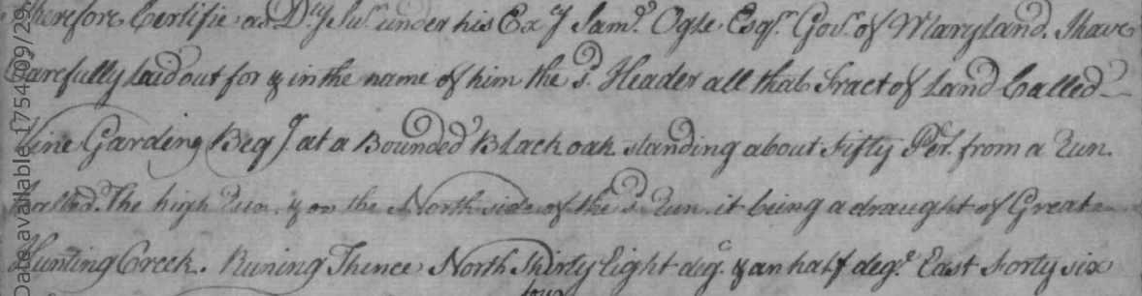
A couple small (hopefully) problems are that according to the ‘Vine Garding’ survey (the original ‘Wine Garden’ survey and why it is important to have an interdisciplinary and collaborative research approach for this type of project:
The following describes the two different tree references for the same tree:
According to the Dear Lane patent, Wine Garden connects with Dear Lane at the same beginning "Beginning at a bounded white Oak , the Beginning Tree of Wine Garden granted Martin Wetsell and Running thence N.“ ((Frederick Co., Survey), Patent# 1084, ‘Dear Lane’, 10.5 acres, Peter Copeland, 1773.) the original patent to George Header says the beginning tree is a black oak about 50 perches from ‘High Run’:
((Frederick Co., Survey), Patent# 4962, ‘Vine Garding’, 100 acres, George Header, 1750.)

Slide 11
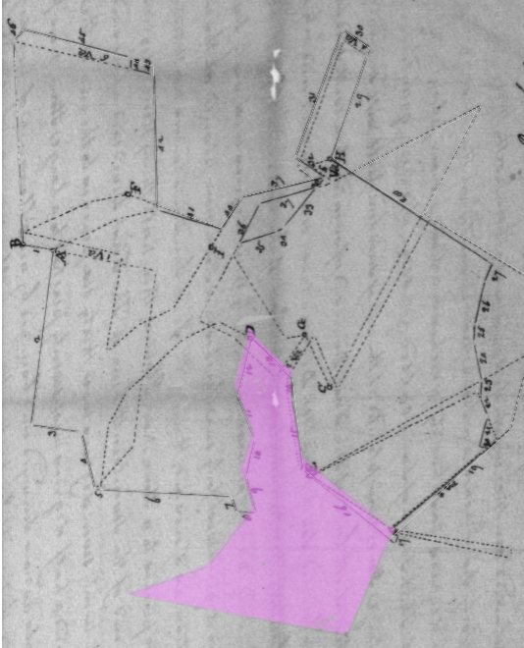
4. Resurvey on Part of the Resuvey on Bonnett's Resolution (South & Center)
according to the Resurvey on Bonnetts Resolution plat dated 1802, BEFORE the resurvey for Auburn plat of 1803/1804, there is metion of a boundary stone being at "hunting creek", which would be Little Hunting Creek; "... twenty perches to a stone No. 1 planted in hunting creek." ((Frederick Co., Survey), Patent# 3786, ‘Resurvey on Part of the Resurvey on Bonnet’s Resolution’, 199 acres, Elias Lefever, 1801.)
Here is mentioning of ‘Wine Garden’, Bonnet family & origin, Martin Wetzel, & Daniel Dulany ...
"In 1743 Wetzel also received the patent for 'Bonnet's Resolution' which had been surveyed for Daniel Dulany on Nov 11, 1742. This he had enlarged in 1742 to 400 acres and in 1753 conveyed it to Daniel LeFever.“ (Tracey & Dern, p 208-9)
(Frederick Co., Survey), Patent# 3786, ‘Resurvey on Part of the Resurvey on Bonnet’s Resolution’, 199 acres, Elias Lefever,, 1801

Slide 12
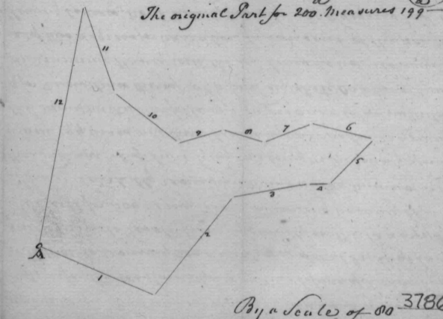
Bonnets Res … Cont.
"Jacob Bonnet - so the 1733 ship's captain as well as subsequent Maryland records spelled the name first appeared in Maryland land records ten years later. He received from Daniel Dulany on May 28, 1743 the cert. of survey for 'Wine Garden' which he then reassigned to Martin Wetzel.” … then in 1743, Jacob Bonnet received a patent for a tract of land recorded as ‘Battleham’. … "Most of the Bonnets moved on to Rockingham County, Virginia.“ **The name Jaques Bonet … is spelling given by the 32 –year old immigrant who arrived at Philadelphia on the August 27, 1733 abourd the ship Elizabeth.” (Tracey & Dern, p214-5)

Slide 13
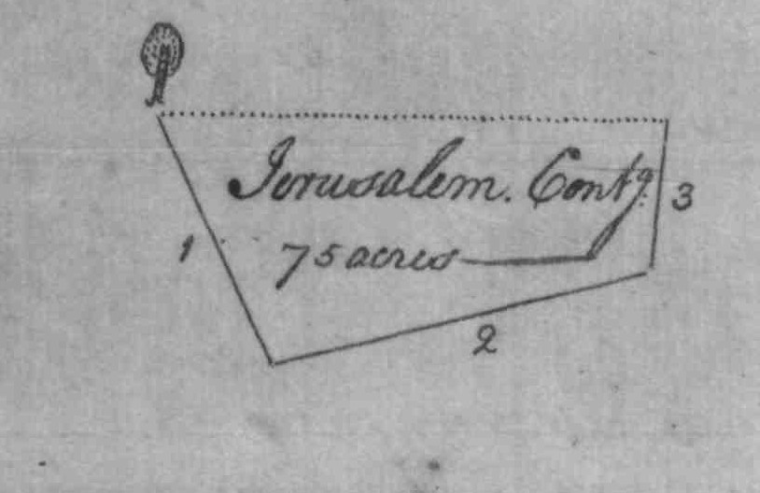
5. Jerusalem (South-East)
‘Jerusalem’ begins about 18 or 20 perches from North East side of Little Hunting creek AND near Bonnet’s Resolution ...
"Beginning at a Bounded white oak standing near a Line of a Tract of Land Called Bonnet's Resolution on the North East side of Little Hunting Creek about eighteen or twenty perches from the said Creek ..."
((Frederick Co., Survey), Patent# 2171, ‘Jerusalem’, 75 acres, Nicholas Vitzel, 1749.)
*Note: name spellings – ‘Vitzel’ / ‘Wetzel’, etc.*

Slide 14
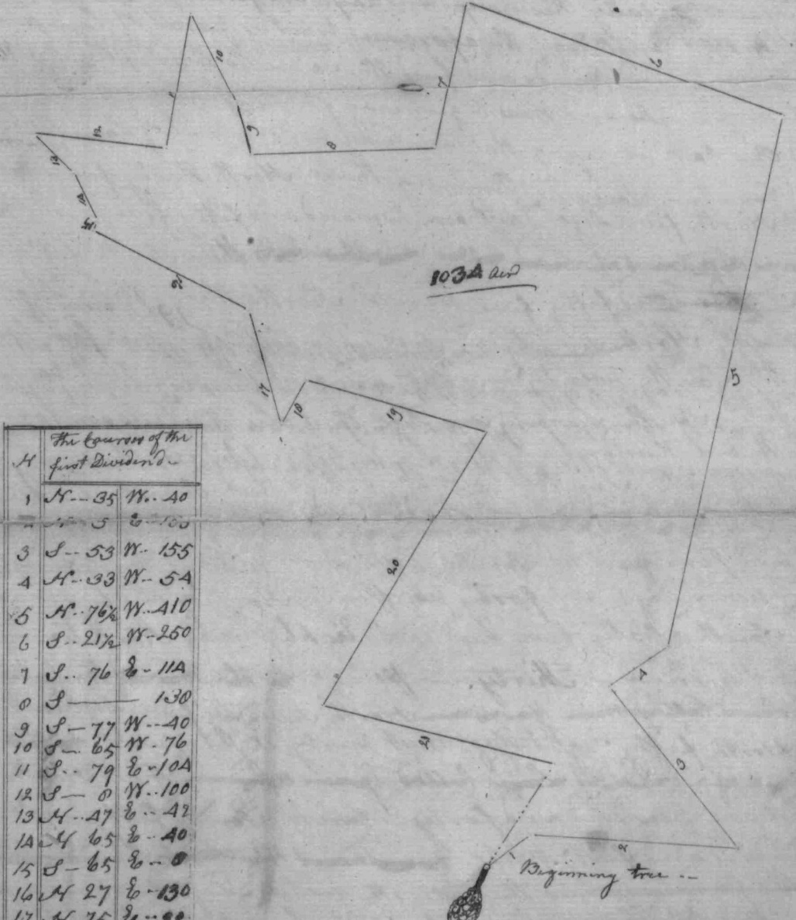
6. First Dividend (North &/or NorthWest)*(?)
Some History!!!
(Frederick Co., Survey), Patent# 1388, ‘First Dividend’,
1034 acres, Charles Carroll Barrister,, 1766.)

Slide 15
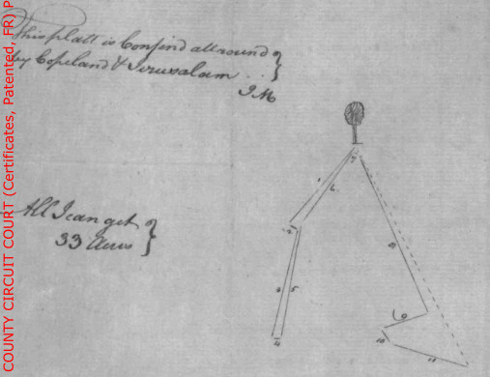
7. All I Can Get (SE)
---> "This platt is confined all around by Copeland & Jeruselam <signed: J.M.>" ((Frederick Co., Survey), Patent# 279, ‘All I Can Get’, Thomas Brooke, 1768.)
----> "All I Can Get ... Beginning at the Beginning line<sic> of Copeland granted Peter Copeland is being also the Beginning line<sic> of a Tract of Land called Jeruselam in possesion of Frederick Willhite..." ((Frederick Co., Survey), Patent# 279, ‘All I Can Get’, Thomas Brooke, 1768.)

Slide 16
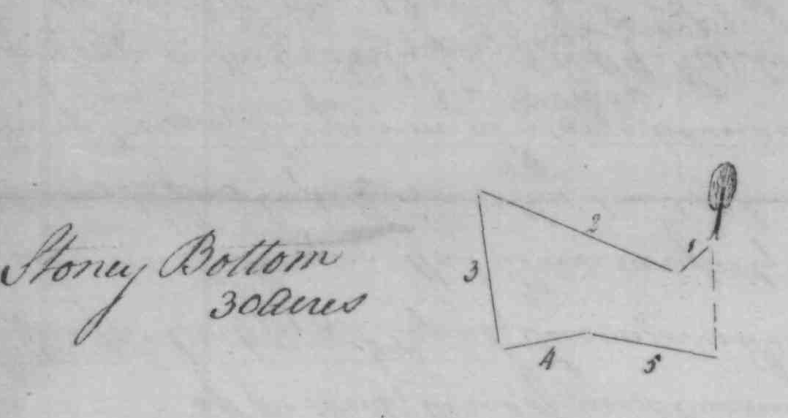
8. Stoney Bottom (center)
"Beginning at a large bounded white oak standing in a large swamp on the Easterly side of Little Hunting Creek running thence South...“
((Frederick Co., Survey), Patent# 4559, ‘Stoney Bottom’, 30 acres, Peter Copeland, 1760.)

Slide 17
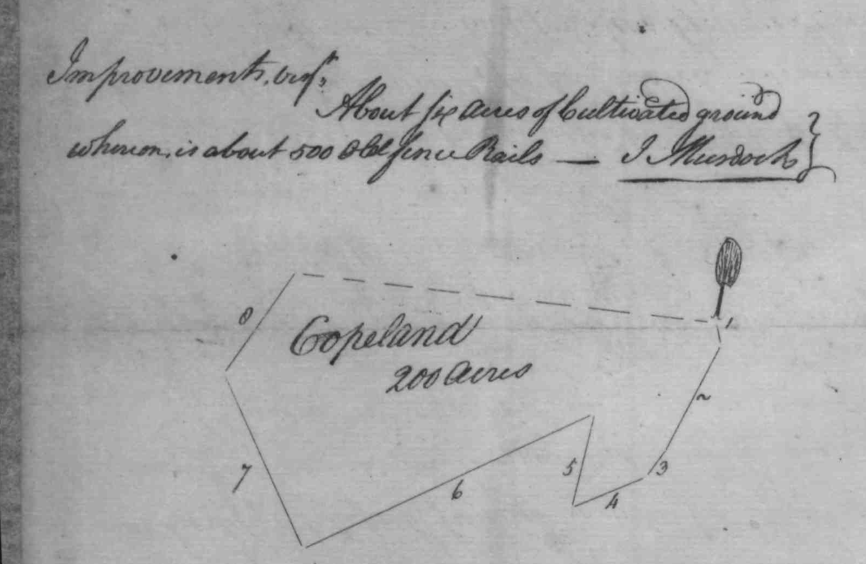
9. Copeland (se – center)
((Frederick Co., Survey), Patent# 980, ‘Copeland’,
200 acres, Peter Copeland, September 6th, 1760.)

Slide 18
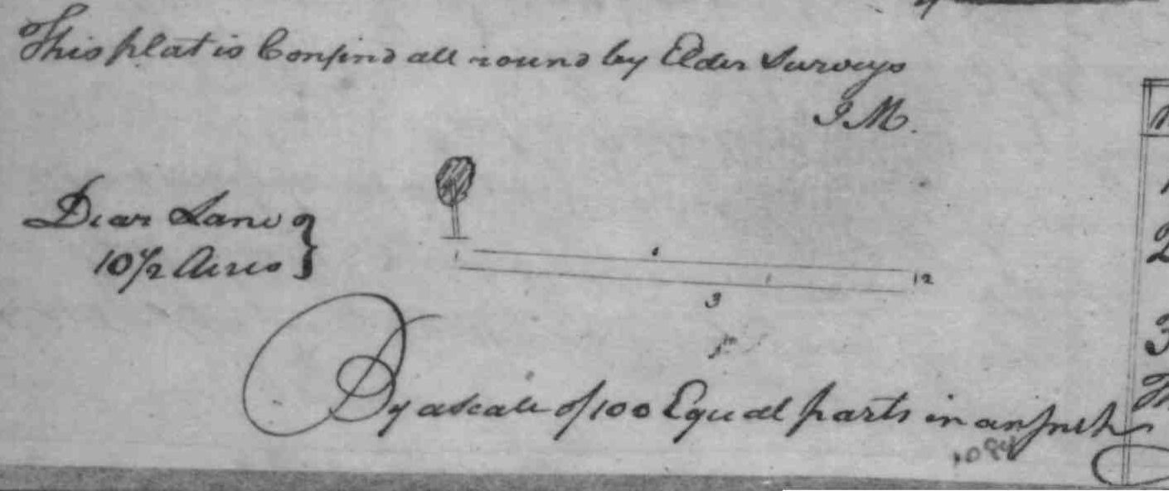
10. Dear Lane (center & east)*(?)
Dear Lane patent obtained from Peter Copeland & "Beginning at a bounded white Oak, the Beginning Tree of Wine Garden granted Martin Wetsell and Running thence N." ((Frederick Co., Survey), Patent# 1084, ‘Dear Lane’, 10.5 acres, Peter Copeland, 1773.)

Slide 19
11. A Cold Friday in April (North)*(?)
((Frederick Co., Survey), Patent# 888, ‘A Cold Friday In April’, 28 acres, Baker Johnson, Mar 26, 1795.)

Slide 20
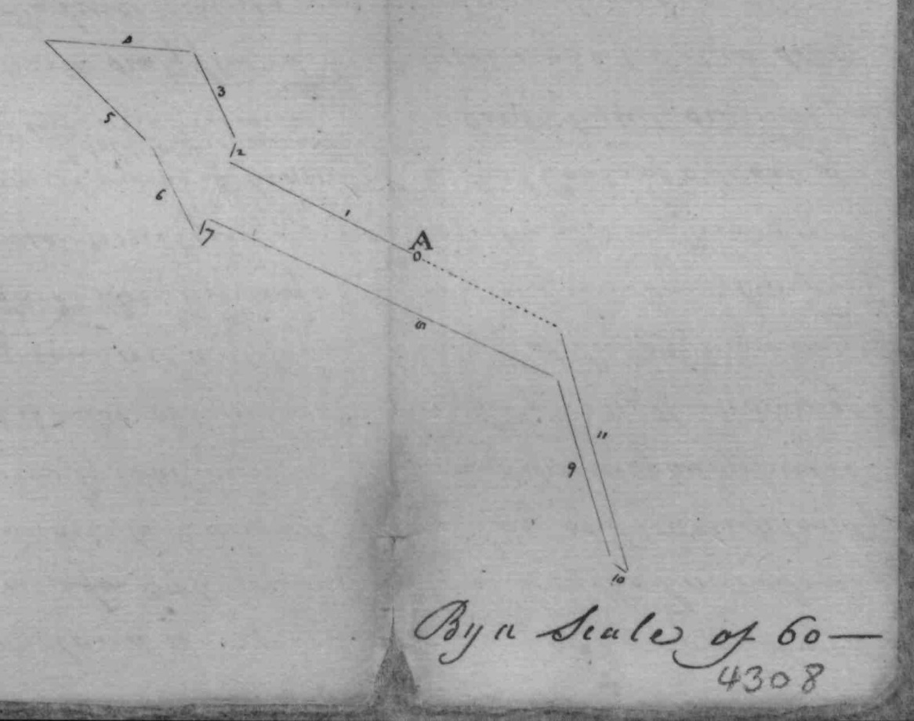
12. Self Defence
(Frederick Co., Survey), Patent# 4308, ‘Self Defence’, 29 acres, Baker Johnson, Clerk JC 2/115, Dece 6th, 1802

Slide 21
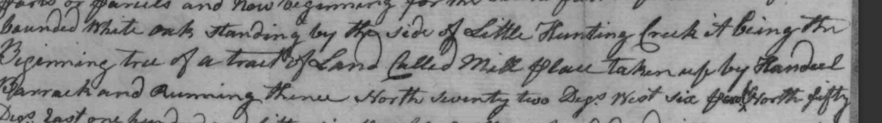
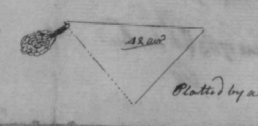
Second Dividend
(Frederick Co., Survey), Patent# 4277, ‘Second Dividend’, 42 acres, Charles Carroll, Barrister, BC & GS 30/153, Jun 26th, 1766

Slide 22
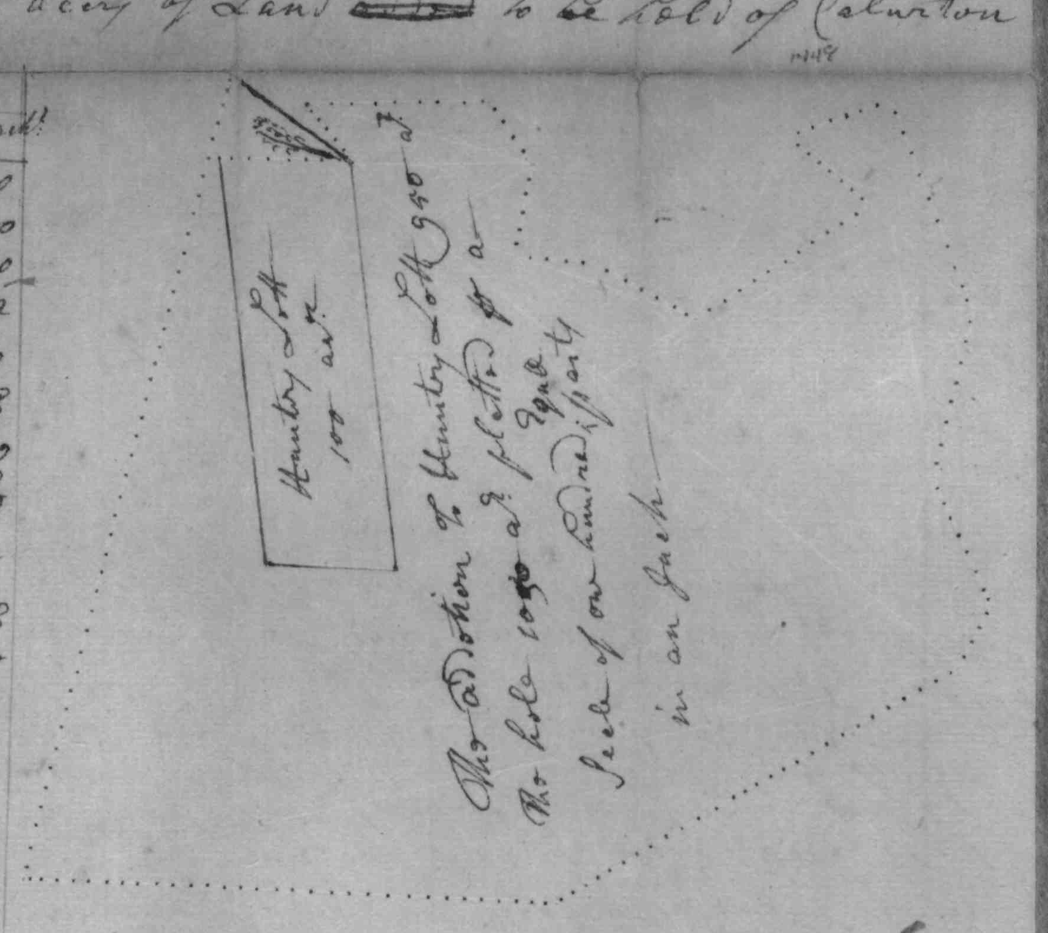
Fountain Low (East) (part of Auburn)
"about a half mile north of Michael Reisner's plantation ... 'Hunter's Lot' ... beginning point .... at a spring on the west side of Hunting Creek about two miles from the mountain, the land lying on both sides of the creek." ... in 1748 Joseph Ogle "had it resurveyed into 'Fountain Low'", (Tracey & Dern, pp 198-9).
(Frederick Co., Survey), Patent# 1448, ‘Fountain Low’, 1050 acres, Joseph Ogle, 1750

Slide 23
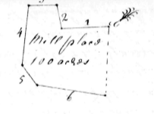
Mill Place (center- West)
"...Mill Place beginning of a bounded white oak Standing on the East Side of Little hunting Creek near the Lower End of Small Island on the said crook running thence South..." ... 1741
It is possible that this had been Wetzel's home before the date of survey, but he assigned the certificate to Handel Barrick who received the patent on Oct 26, 1742. In 1884 this land was in possession of George W. Gaver.", (PoOOM, <cite>)
(Prince George Co., Survey), Patent# 217, ‘Mill Place’, 100 acres, Martian Whitsail, 1741
[Note: *aka. Martin Wetzel*]

Slide 24
II. Parcels mentioned & modern resurveys or name changes associated/connected to, or resurveyed/included with
Auburn but not necessarily part of original Auburn Plat.

Slide 25
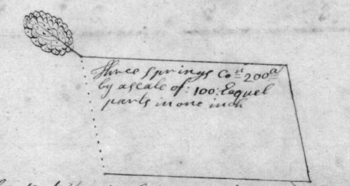
Green Springs (North- Catoctin Furnace)*
Michael Reisner
Denton Jaques
?
((Prince George Co., Survey), Patent# 2155, ‘Green Spring’, 200 acres, George Bear, Clerk LG C/35 AND Clerk E<sic> 4/540, Feb 8th, 1738

Slide 26
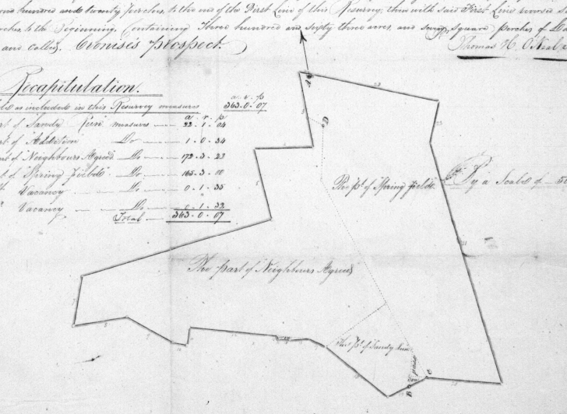
Springfield (South – Springfield Manor & Gardiner Estate Parcel No.?)

Slide 28
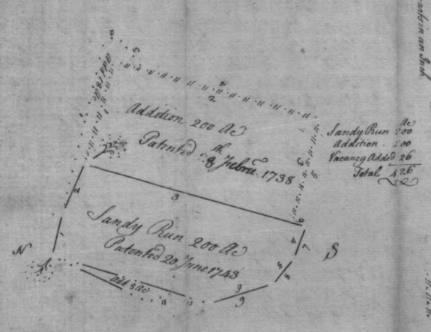


Sandy Run (South)*
<source: Bernard Weymards Lands – Sandy Run Addition, 1749 (pdf)>
<source: Schley-Leatherman_HS-8-511_1839_Springfield-NeighborsAgreed-MtTract.pdf>

Slide 29
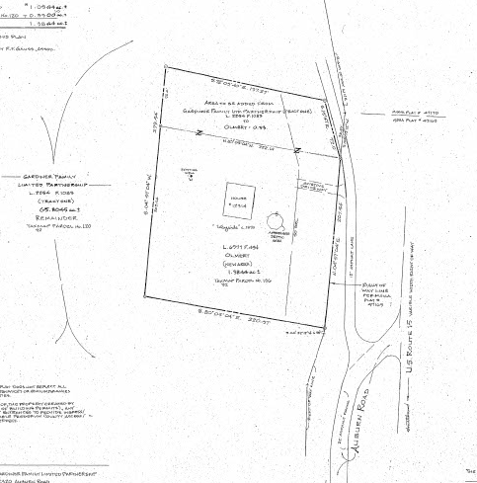
Stackhouse, Wayside House, … other Features

Slide 30
McAdam’s Division (South)

Slide 31
History of HWYs & Rds
Hesson Br Rd
<the “Main Road mentioned in the Surveys and Deeds”>
Blacks Mill Rd
‘Sphar rd(?)’
Auburn HWY 806
HWY 15
Turnpikes
HWY 806
HWY 12
Baugher Rd.
Kelly’s Store Rd.
Sphar(?) Rd.
Black Mills R.
“Coal Rds”

